Slide 1
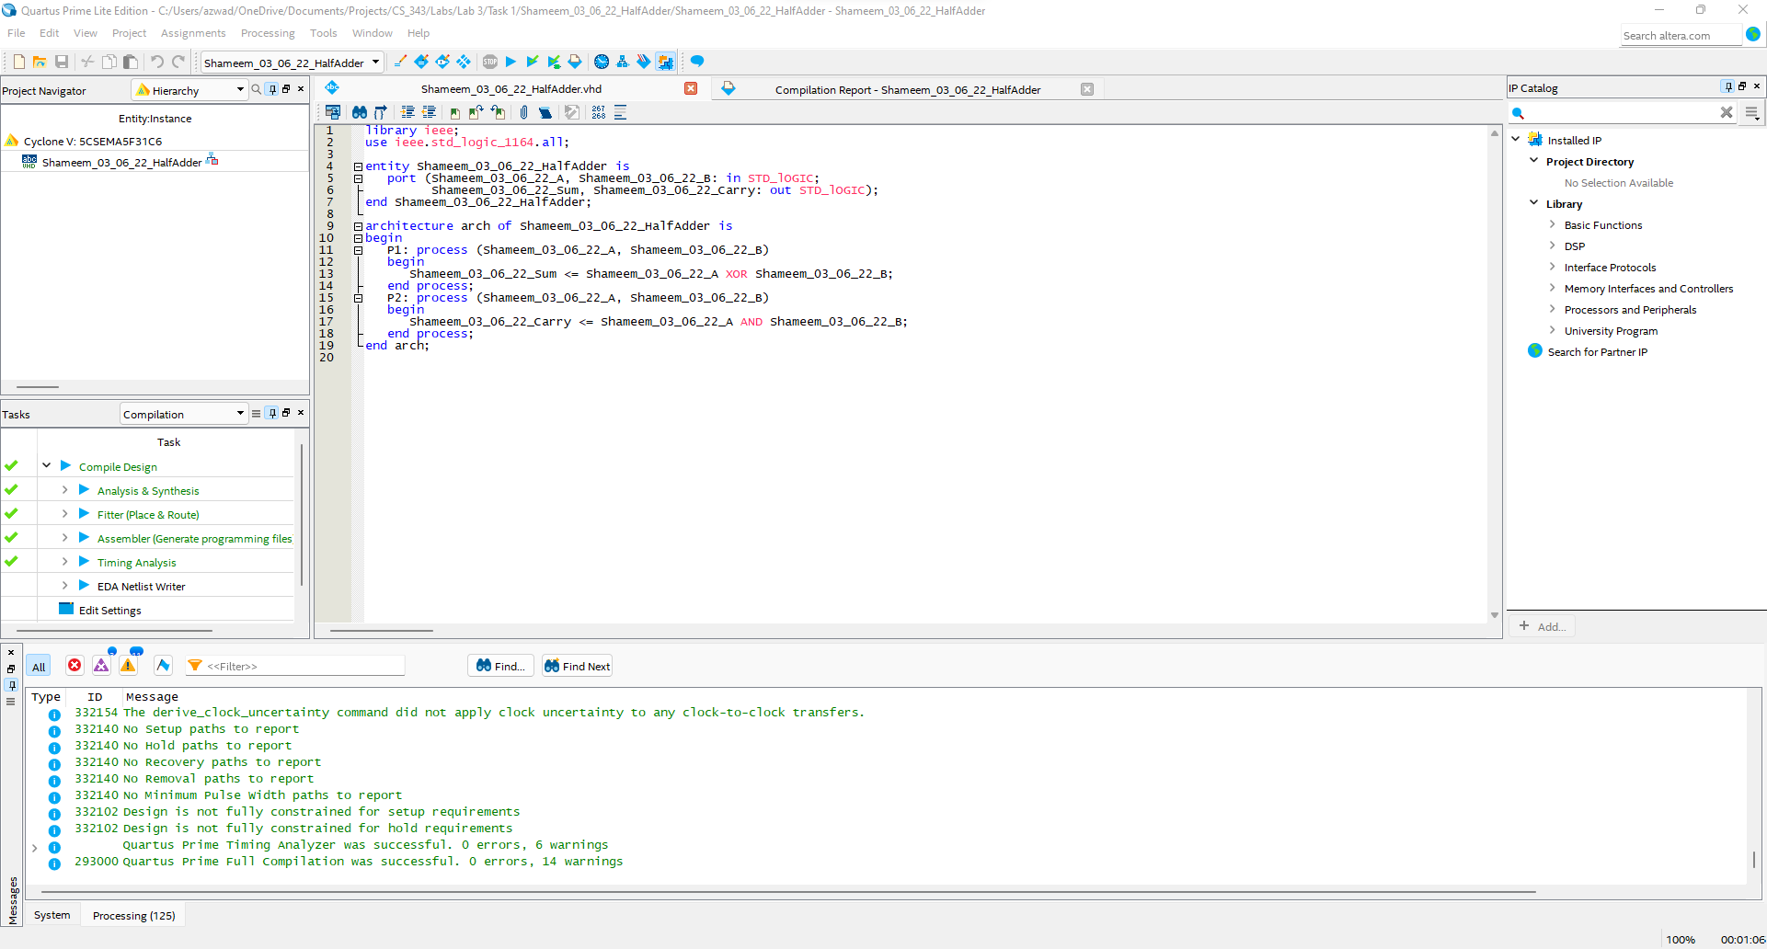
Task 1 Design in VHDL Half adder using two processes

Slide 2
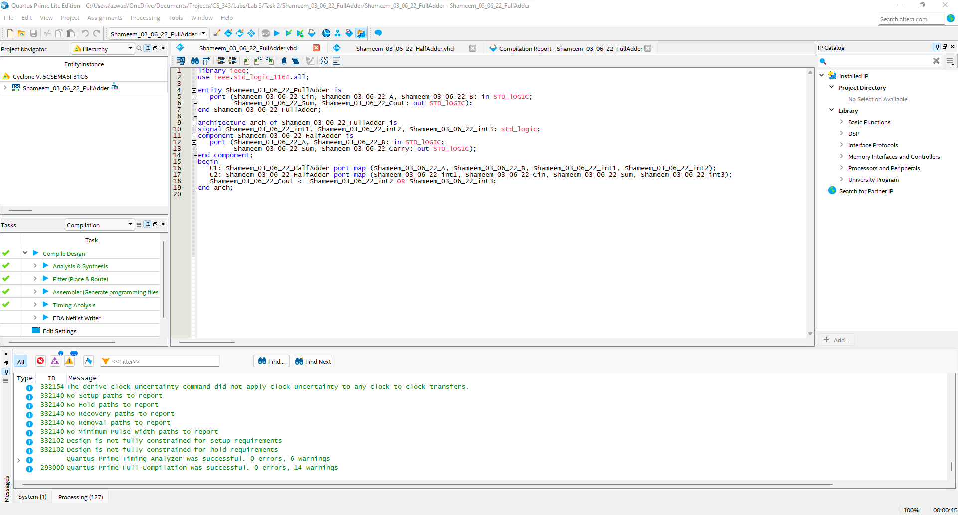
Task 2 1-bit Full-adder using Half adder as a component

Slide 3
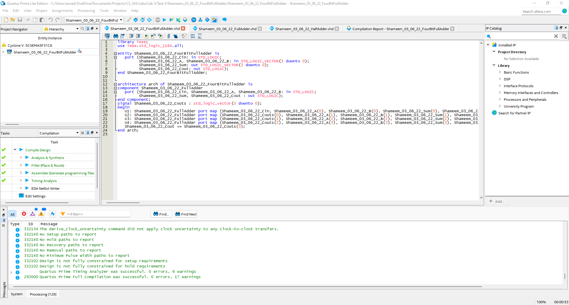
Task 3 Design N = 4-bit adder using 1-bit Full adder as a component

Slide 4
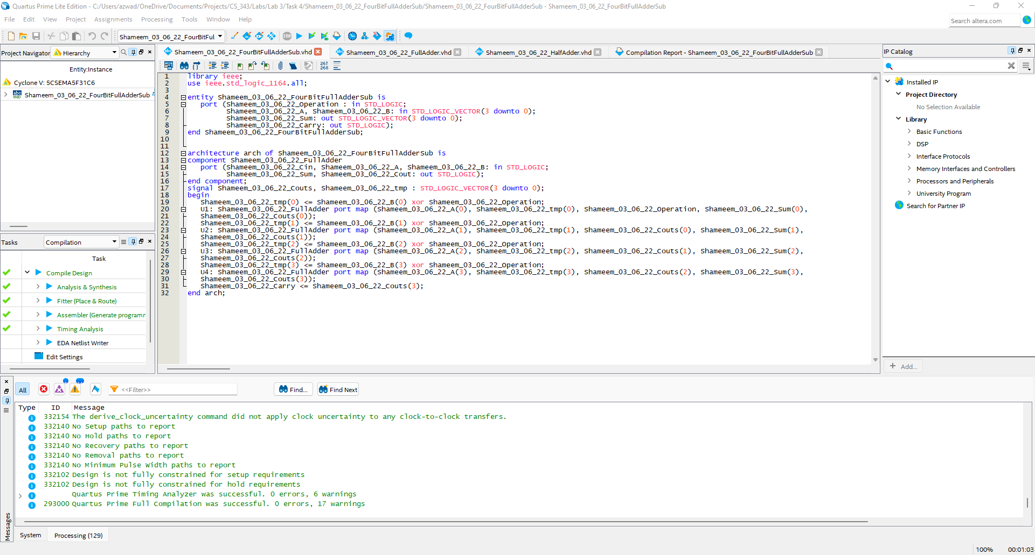
Task 4 Design N = 4 bit a add/sub that performs addition when the operations code = 0 and subtraction when the operations code = 1

Slide 5
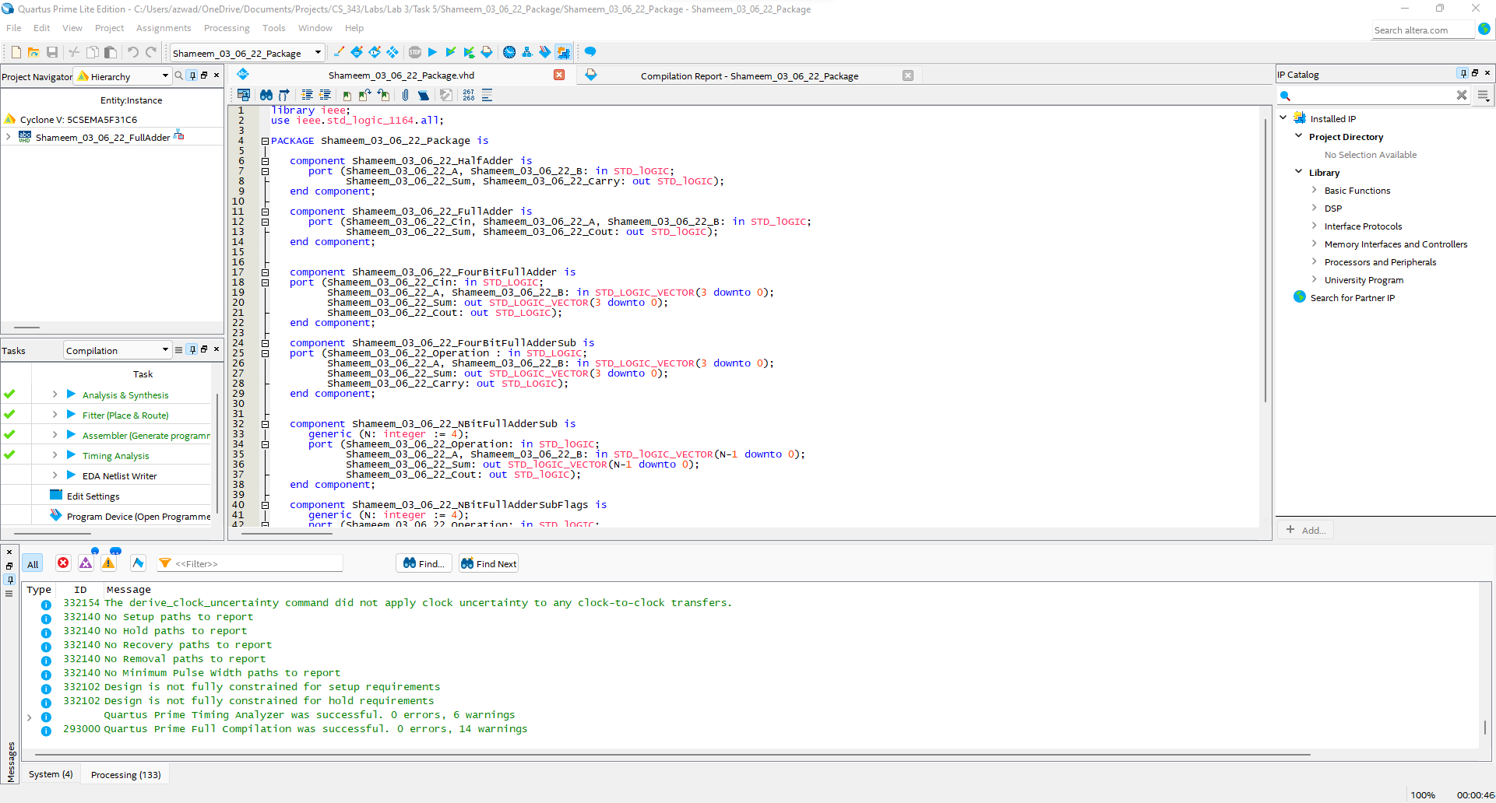
Task 5 Create a package where you put all components for future use (Your last name is part of package name)

Slide 6
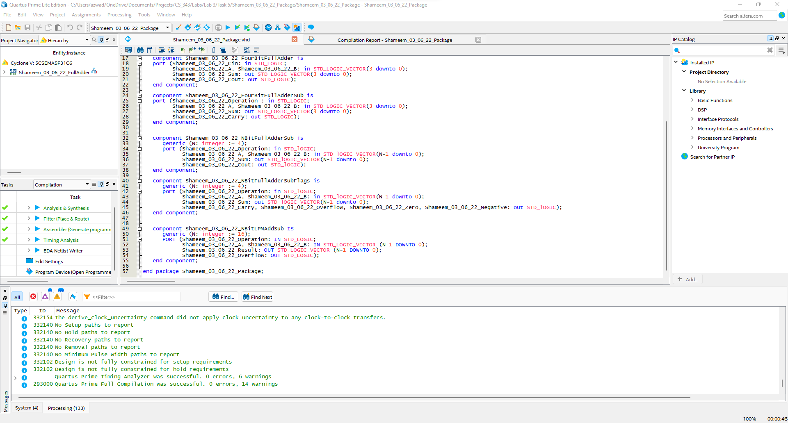
Task 5 - continued Create a package where you put all components for future use (Your last name is part of package name)

Slide 7
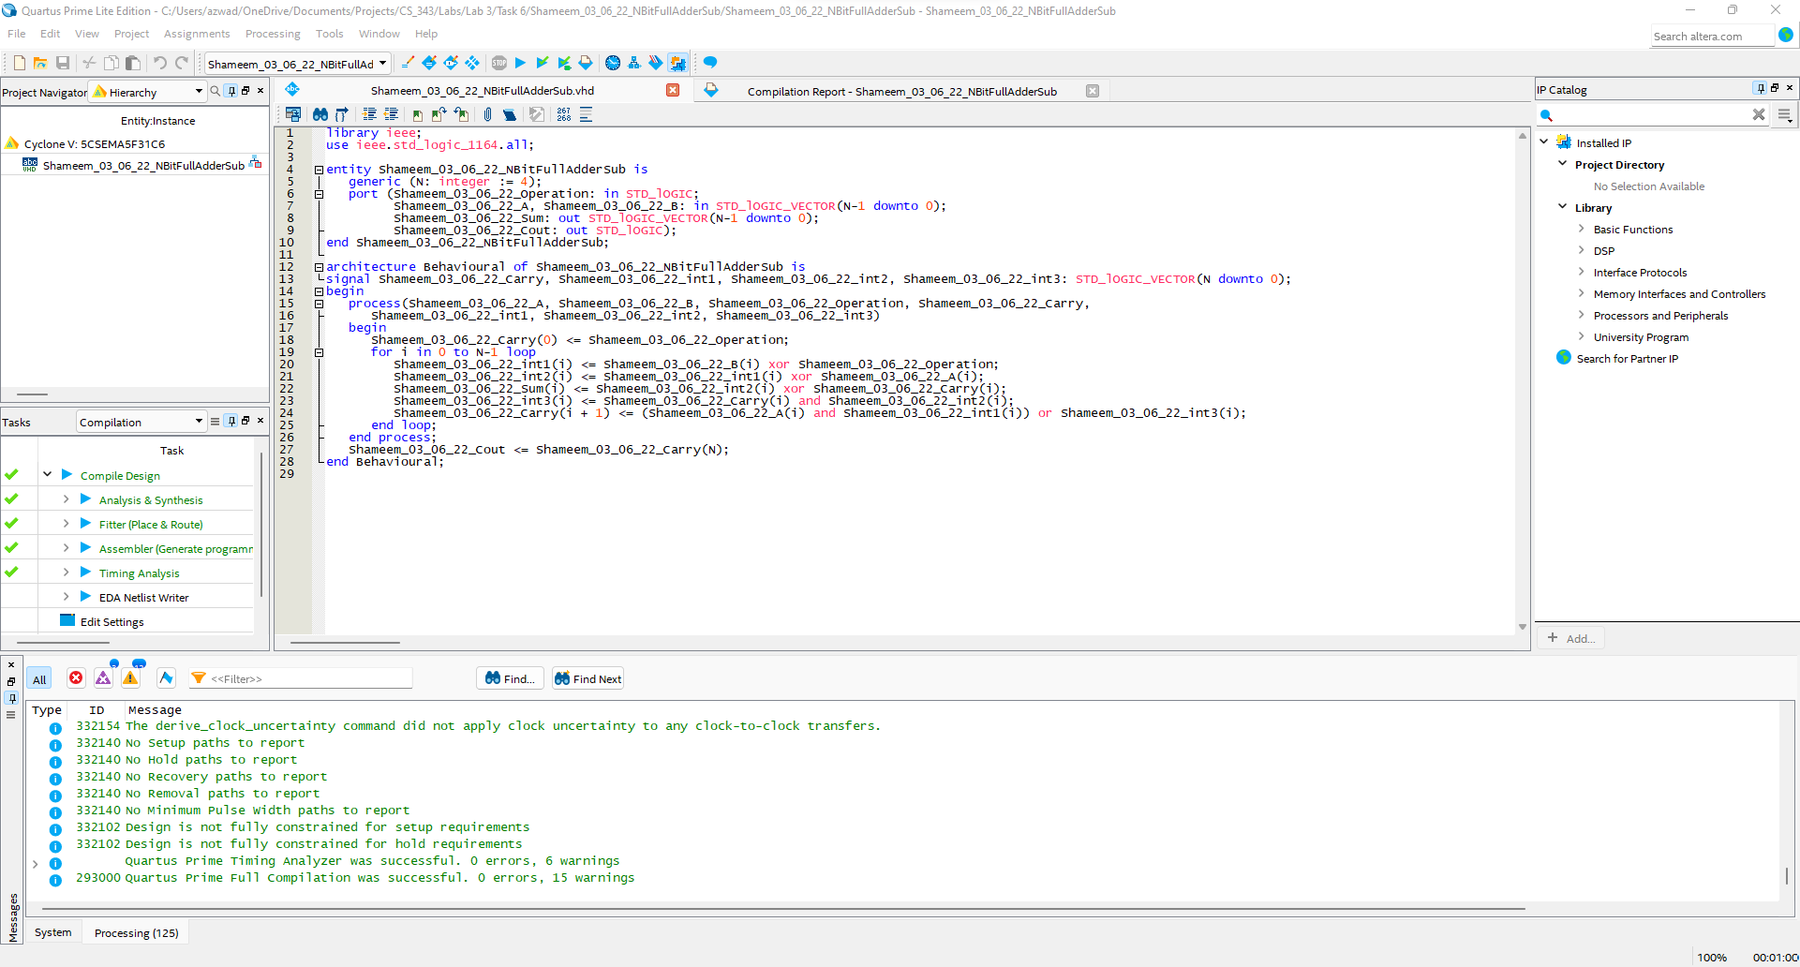
Task 6 Design N – bit add-sub unit using behavioral VHDL model

Slide 8
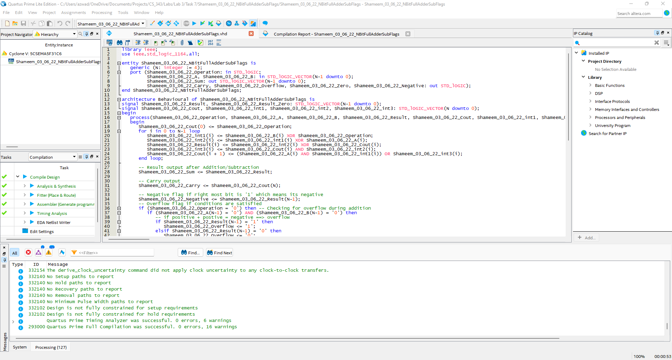
Task 7 You have to design a circuit to output OVERFLOW , ZERO, NEGATIVE flags for N-bit add/sub.

Slide 9
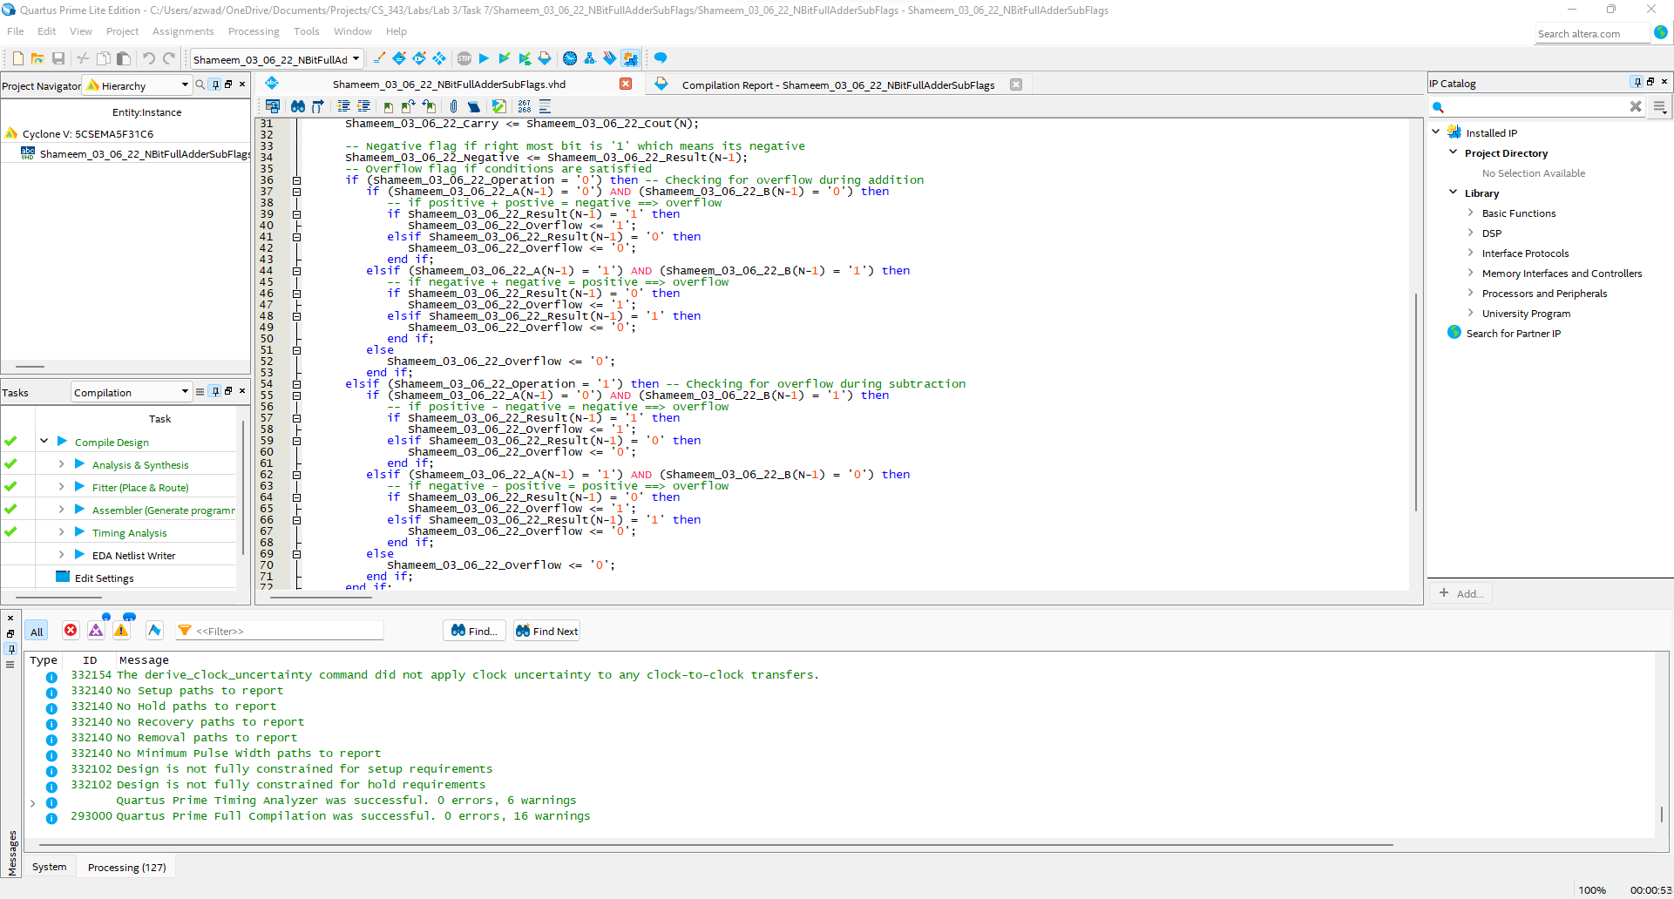
Task 7 You have to design a circuit to output OVERFLOW , ZERO, NEGATIVE flags for N-bit add/sub.

Slide 10
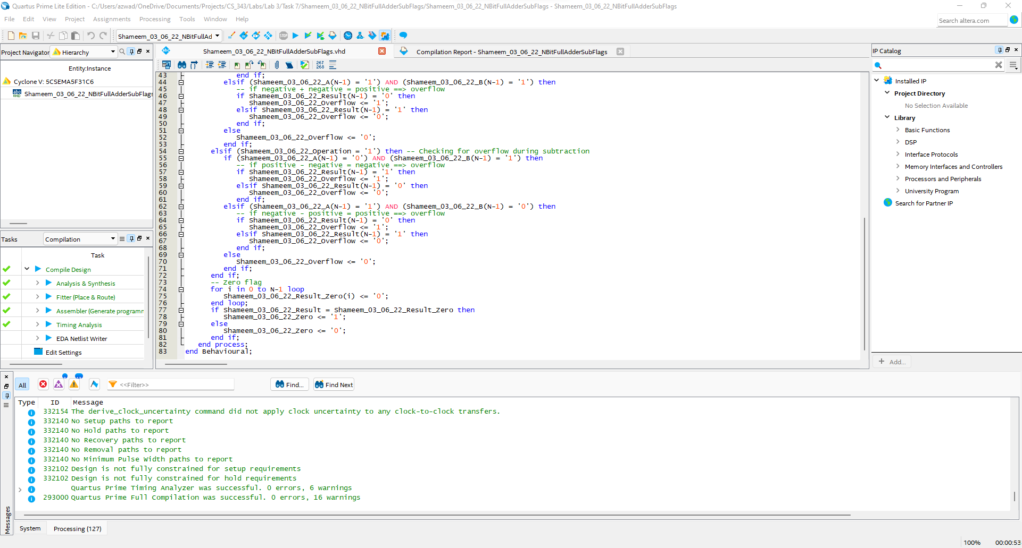
Task 7 You have to design a circuit to output OVERFLOW , ZERO, NEGATIVE flags for N-bit add/sub.

Slide 11
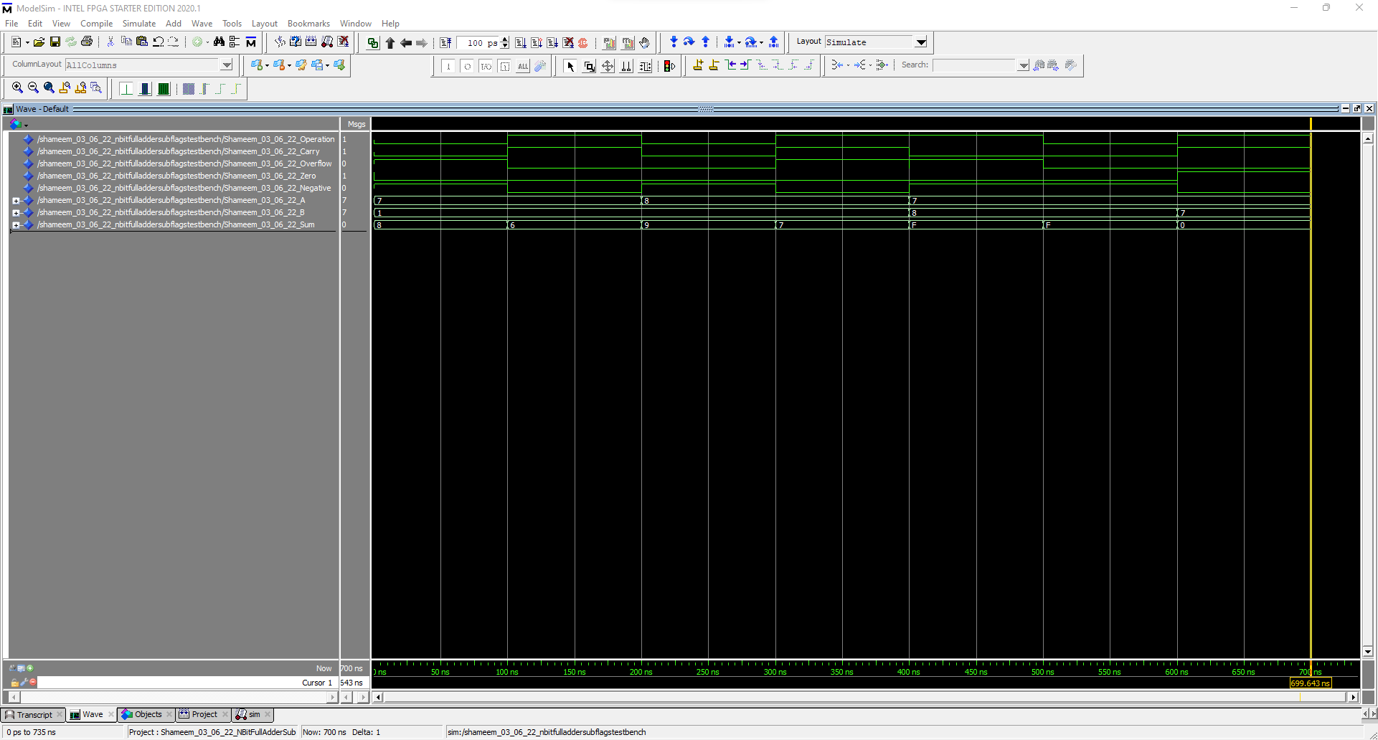
Task 8 – 4 bit For N=4, and N=32 bits using Most positive, Most negative integer as a first operand, and integers 1 and/or 2 as a second operand. You have to demonstrate that flags are set correctly in appropriate cases

Slide 12
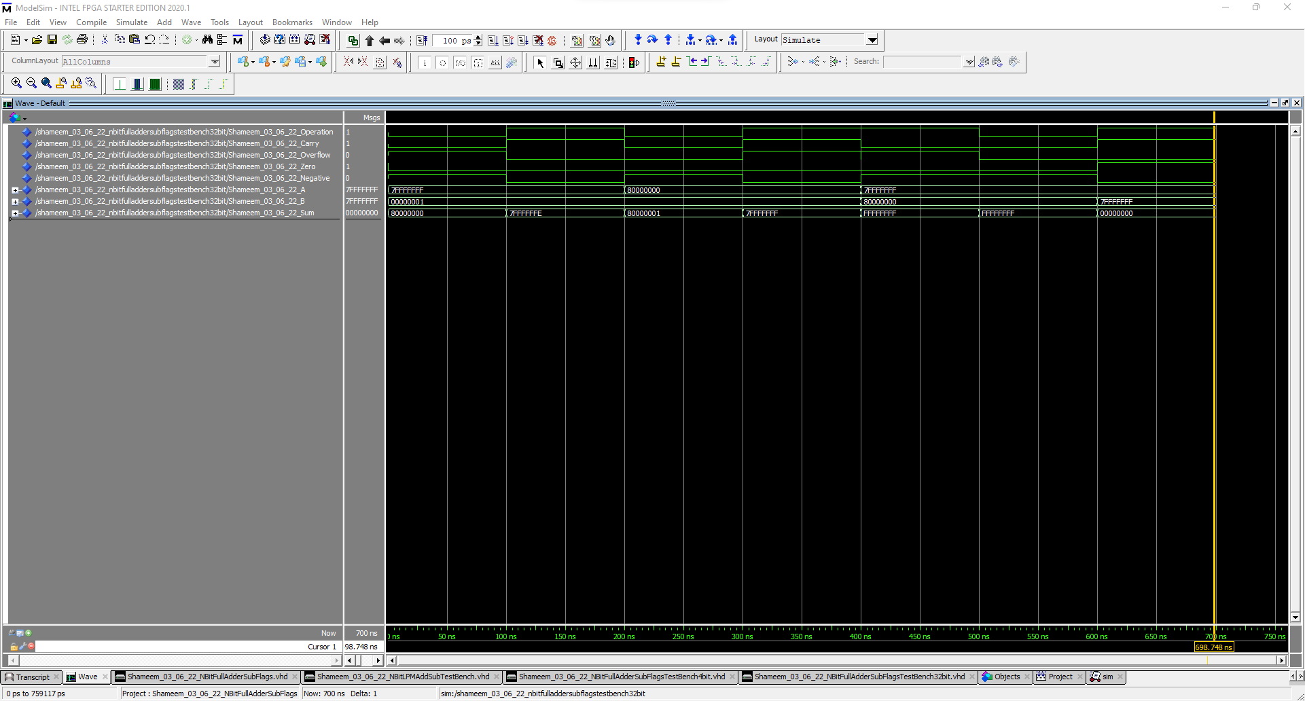
Task 8 – 32 bit For N=4, and N=32 bits using Most positive, Most negative integer as a first operand, and integers 1 and/or 2 as a second operand. You have to demonstrate that flags are set correctly in appropriate cases

Slide 13
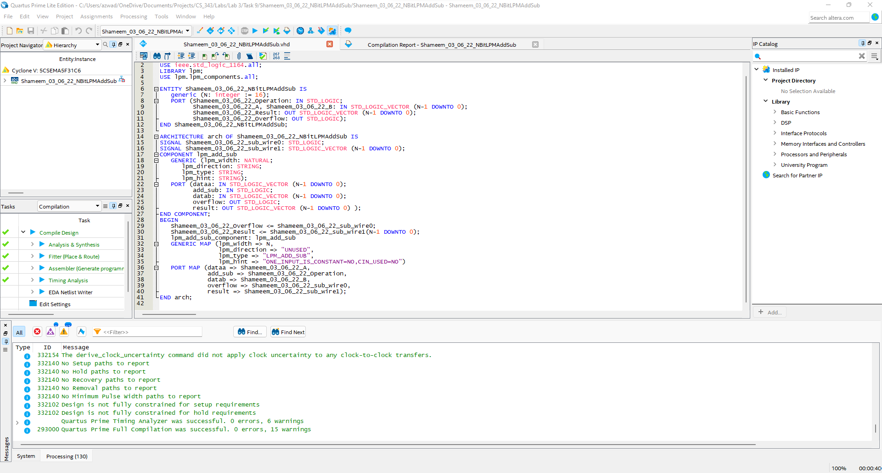
Task 9 Create N-bit adder/subtractor unit using lpm and compare waveforms with your design

Slide 14
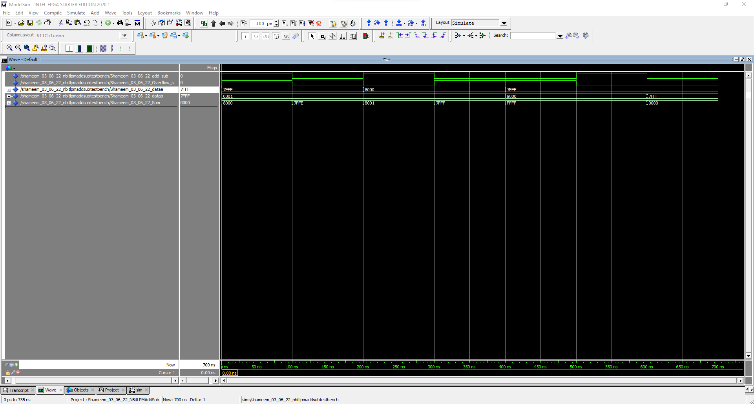
Task 9 Create N-bit adder/subtractor unit using lpm and compare waveforms with your design

Slide 15
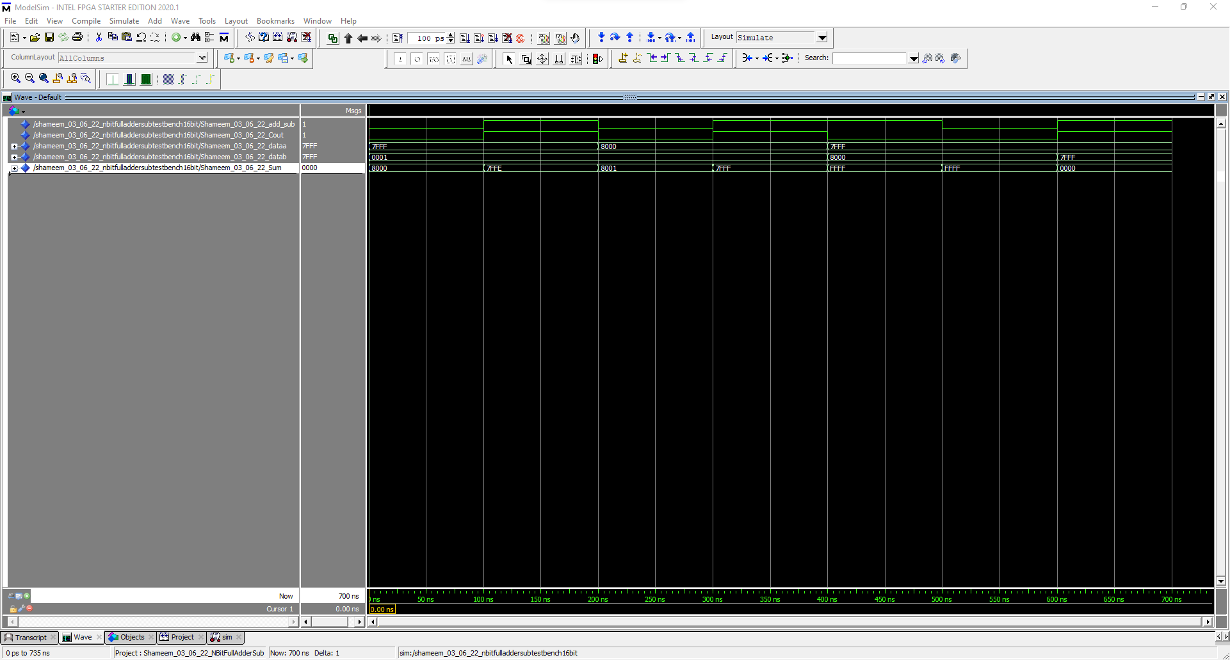
Task 9 N-bit Add/Sub 16-bit waveform to compare with LPM waveform

Slide 16
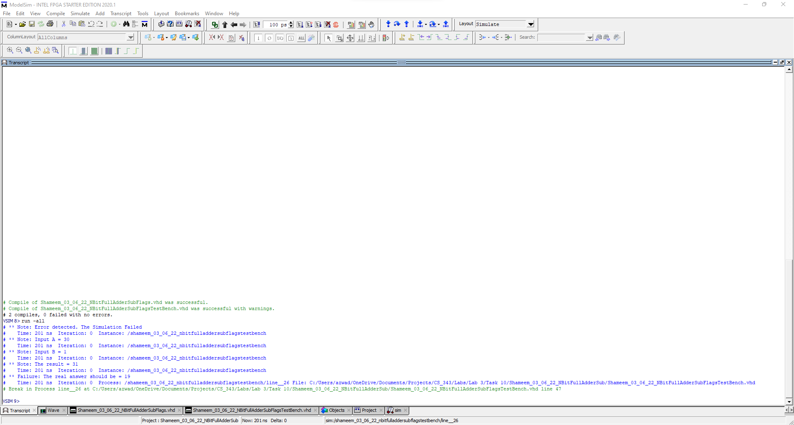
Task 10 Create a Test-Bench file in VHDL to test add_sub unit for n=16 bits. Please demonstrate that the test-bench detects an error (intentionally created) in your design and prints out simulation time, expected operand 1 and operand result value, actual result value, and values of operand 1 and operand 2 that caused the error.

Slide 17
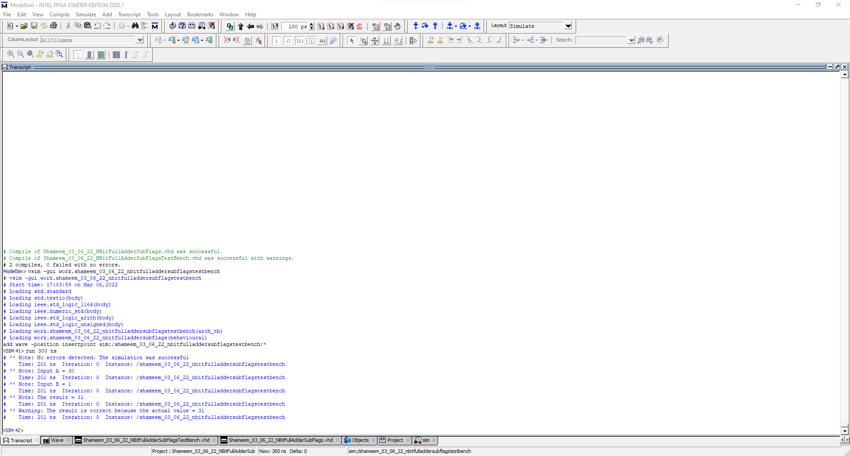
Task 10 Create a Test-Bench file in VHDL to test add_sub unit for n=16 bits. Please demonstrate that the test-bench detects an error (intentionally created) in your design and prints out simulation time, expected operand 1 and operand result value, actual result value, and values of operand 1 and operand 2 that caused the error.

